Slide 1
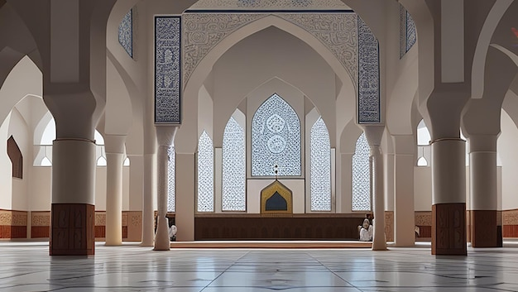
The Blessed Month
Welcome
Ramadan
A journey of faith, reflection, and spiritual growth for Muslim students in the West
Quranst.com

Slide 2
Understanding
What Is Ramadan?
The Month of the Qur'an
The Ninth Month
Ramadan commemorates the month when the Qur'an was first revealed to Prophet Muhammad (PBUH). This divine connection makes it the perfect time to deepen your relationship with the holy book.
Ramadan is the ninth month of the Islamic lunar calendar. It is a time when Muslims worldwide observe fasting from dawn to sunset each day.
More than abstaining from food—it's spiritual renewal
One of Five Pillars
Fasting during Ramadan is one of the Five Pillars of Islam—the core acts of worship that define a Muslim's faith and practice.
Faith
Discipline
Reflection

Slide 3
Spiritual Significance
Why Ramadan
Matters
A Transformative Journey
Ramadan is not just a month—it's a transformative journey that shapes your character, deepens your faith, and strengthens your connection with Allah for the entire year.
Spiritual Purification
Ramadan offers a unique opportunity to purify your heart, seek forgiveness for past mistakes, and start fresh with renewed faith and intention.
Developing Taqwa
Increased patience and self-control
Taqwa means God-consciousness—being aware of Allah in every moment. Fasting cultivates this awareness, helping you make better choices throughout the year.
Greater gratitude for daily blessings
Mindfulness in thoughts and actions
Building Empathy
Experiencing hunger and thirst helps you understand the struggles of those less fortunate, inspiring compassion and charitable action.

Slide 4
Sawm
The Purpose of Fasting
More than abstaining from food—fasting is a complete spiritual practice
Self-Discipline
Gratitude & Appreciation
Beyond Physical
Fasting teaches you to control your desires and impulses. When you resist food and drink despite hunger, you strengthen your willpower and learn to master your self.
When you break your fast, you truly appreciate the blessing of food and water. This experience cultivates deep gratitude for daily necessities often taken for granted.
True fasting includes guarding your tongue from negative speech, controlling anger, avoiding harmful behaviors, and maintaining kindness even when hungry or tired.
"The strong is not the one who overcomes people, but the one who controls himself." — Prophet Muhammad (PBUH)
Experiencing hunger helps you value every meal and every sip of water.
The goal: becoming a better person in every aspect of life.
Fasting is not about suffering—it's about growth, awareness, and becoming closer to Allah

Slide 5
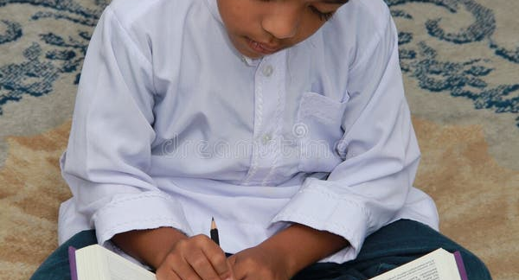
Spiritual Connection
Prayer &
The Qur'an
Completing the Qur'an
Many Muslims aim to complete the entire Qur'an during Ramadan by reading one Juz (section) each day. This creates a consistent daily connection with Allah's words.
30 Days
30 Juz
1 Complete Qur'an
The Month of the Qur'an
Ramadan is traditionally called the "Month of the Qur'an" because it was during this blessed month that the holy book was first revealed to Prophet Muhammad (PBUH).
Tarawih Prayers
Special nightly prayers held after Isha where portions of the Qur'an are recited in congregation. These prayers create a beautiful communal experience of worship.
"The month of Ramadan is that in which the Qur'an was revealed as guidance for people..." — Qur'an 2:185
Held after Isha prayer
•
Congregational recitation
Ramadan is the perfect time to establish or strengthen your daily relationship with the Qur'an

Slide 6
Personal Growth
Building Character
Ramadan naturally develops virtues that transform who you are
Patience (Sabr)
Gratitude (Shukr)
Self-Control
Every moment of fasting builds patience. From dawn to sunset, you learn to wait with grace, control your desires, and maintain composure even when hungry or tired.
Breaking your fast makes you truly appreciate simple blessings—a glass of water, a date, a warm meal. This gratitude extends beyond Ramadan to all aspects of life.
Fasting teaches you to manage emotions, avoid arguments, and maintain positive behavior. You learn that you have the power to choose your responses.
"If you are grateful, I will surely increase you..." — Qur'an 14:7
"Indeed, Allah is with the patient." — Qur'an 2:153
True strength is controlling yourself when tested
Ramadan helps you become more mindful of your actions and words, striving to embody the best Islamic values

Slide 7
Togetherness
Community &
Connection
The Ummah
Ramadan unites Muslims worldwide regardless of nationality, language, or background. We all fast together, pray together, and celebrate together as one global community.
Family Bonds
Ramadan brings families together for Suhoor (pre-dawn meal) and Iftar (breaking the fast). These shared moments strengthen relationships and create lasting memories.
Charity & Giving
1.9B
30
Muslims are encouraged to increase charity during Ramadan—Zakat (obligatory giving) and Sadaqah (voluntary charity). Helping others is a core part of the Ramadan experience.
Muslims Worldwide
Days of Unity
"The believers are but a single brotherhood..." — Qur'an 49:10
Mosque Community
Mosques become vibrant centers of worship with increased prayers, Qur'an circles, and social gatherings. They provide a sense of belonging and shared purpose.

Slide 8
For Students in USA, Canada & Europe
Living Ramadan in the West
Balancing faith with school, work, and daily life
Long Fasting Hours
Practical Tips
In summer, fasting can last 16-19 hours. Plan your meals carefully during Suhoor and Iftar, stay hydrated, and pace yourself throughout the day.
Plan Suhoor and Iftar meals ahead of time
Drink plenty of water during non-fasting hours
Find and use prayer rooms at school/work
Connect with local Muslim student associations
School & Work Balance
Join community Iftar gatherings at local mosques
Communicate with teachers and employers about your fasting. Most are understanding and accommodating. Schedule demanding tasks earlier in the day when energy is higher.
You're Not Alone
Millions of Muslims successfully observe Ramadan in Western countries. These challenges strengthen your faith and build resilience.
Sharing with Others
Use Ramadan as an opportunity to educate friends and colleagues about Islam. Many are curious and respectful—your openness can build bridges of understanding.

Slide 9
Educational Opportunity
A Time for
Learning
Reading Goals
Set realistic goals: one Juz daily, studying Tafsir (commentary), memorizing new Surahs, or improving your Tajweed (recitation rules).
The Best Time to Learn
Understanding & Reflection
The spiritual atmosphere of Ramadan makes it easier to focus on learning. Your heart is more receptive, your intentions are purer, and your motivation is stronger.
Read translations and Tafsir to understand meanings. Reflect on how verses apply to your life. Quality of engagement matters more than quantity.
"Ramadan offers a fresh start and renewed motivation for deepening your Islamic knowledge."
Study Circles & Groups
Join online or local Qur'an study circles. Learning with others provides motivation, accountability, and deeper understanding through discussion.
Consistency is key—even small daily efforts yield significant spiritual rewards

Slide 10
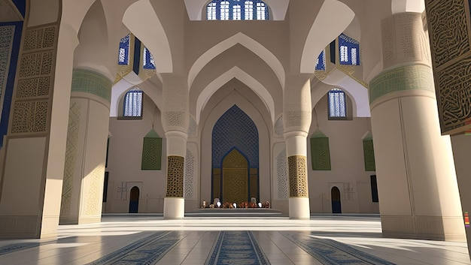
Begin Your Journey
Start Your Ramadan
Journey with Quranst
Transform this blessed month into a life-changing experience. Our expert teachers are here to guide you through personalized Qur'an learning, Tajweed improvement, and Islamic studies—designed specifically for students in the USA, Canada, and Europe.
Complete Your Khatm
Improve Tajweed
Deepen Understanding
Guided reading to finish the Qur'an this Ramadan
Perfect your recitation with expert guidance
Learn Tafsir and Islamic studies with qualified teachers
Start Your Free Trial
+201125722979
quranst.com/free-trial/

