Slide 1


Amin's Big Adventure
The heroic journey of a faithful Muslim merchant in the foggy land of England. An exciting adventure for brave children!

Slide 2


Meet Amin, the Brave Merchant
An Honorable Merchant
Once upon a time, there was a young Muslim man named Amin. Amin was famous for his bright smile, helpful heart, and his absolute honesty.
He packed chests of the most beautiful, shiny, colorful silks in the world to sell in a faraway place called England!

Slide 3
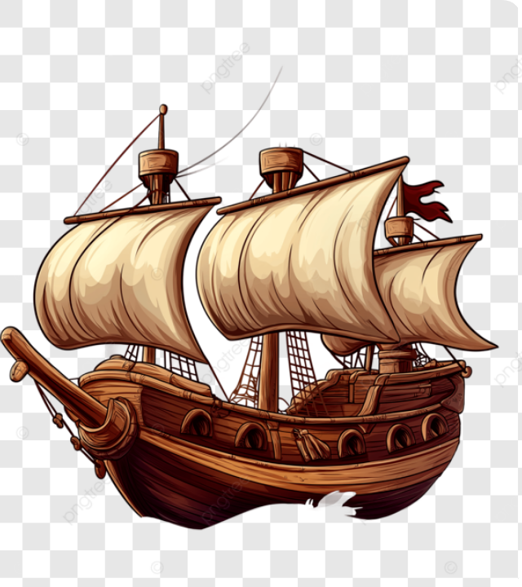

Sailing Across the Deep Sea
A Brave Voyage
Amin boarded a giant wooden sailing ship to cross the wild, wavy oceans.
Through sunny days and starry nights, Amin kept his heart brave, trusting that Allah would protect him on his magnificent journey north.

Slide 4
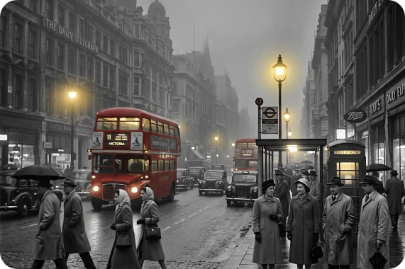
Arriving in the Foggy Land
The Busy City of London
When Amin arrived, London was covered in a soft blanket of thick grey fog and chilly rain!
He set up his market stall. The local people quickly fell in love with Amin because he was always polite, kind, and fair to everyone he met.

Slide 5


The Rich Lord's Purchase
A Splendid Trade
An Unexpected Mistake
One afternoon, a wealthy nobleman named Lord William arrived in a rush. He bought Amin's finest royal blue fabric and handed over a heavy leather coin bag, driving away quickly in his carriage.
As Amin opened the bag to count the gold, his eyes grew wide with shock! Inside, Lord William had accidentally left an extra 100 shiny gold coins that didn't belong to Amin!

Slide 6
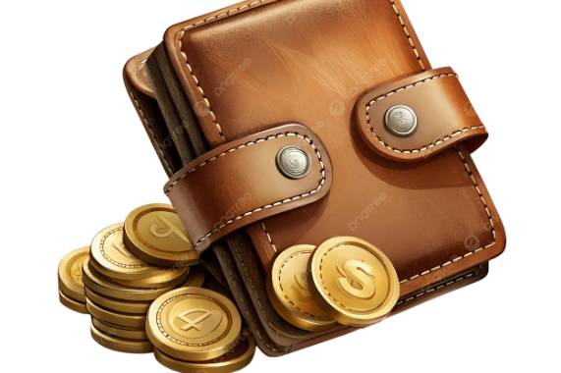
The Big Test of Honesty
Saying No to Greed
A sneaky whisper said: "Keep it! No one is watching you, and the Lord is already incredibly rich!"
But Amin stood tall and declared: "Never! I am a Muslim, and a Muslim never takes what is not theirs. Allah is always watching me!"

Slide 7
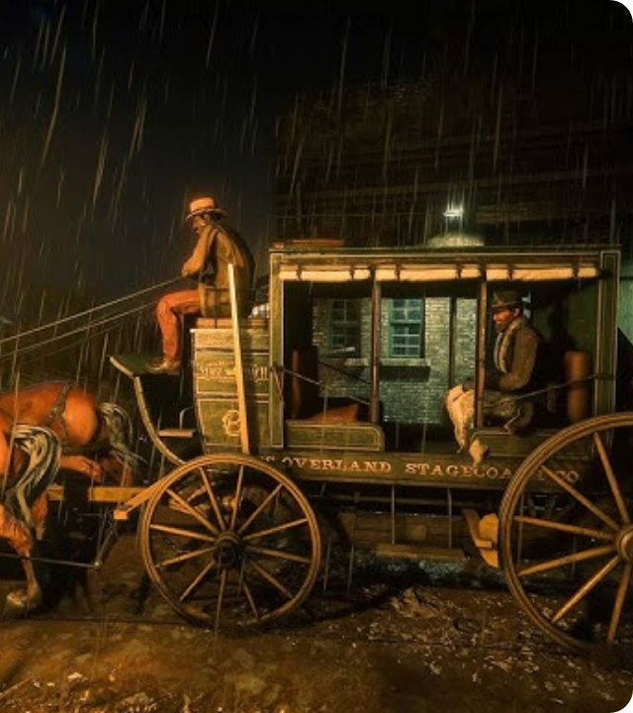

The Midnight Chase in the Rain
No Storm Can Stop Him!
Amin sprinted into the stormy night! The rain was pouring, and mud was flying everywhere.
He ran as fast as his legs could carry him, chasing the fast horse-drawn carriage through the dark, winding streets of London.

Slide 8

Reaching the Grand Gates
Knocking at Dawn
Amin searched all night. Just as the sun began to rise, he finally found Lord William's grand castle standing tall in the mist.
Shivering from the cold, but with a proud smile, Amin knocked loudly on the giant iron gate.

Slide 9


The Ultimate Act of Honesty
"Here is Your Trust!"
Lord William came to the door in pure disbelief! Amin handed him the bag of 100 gold coins and said:
"Sir, you paid too much by mistake. My religion, Islam, teaches me to always return what is not mine."

Slide 10






A Beautiful New Dawn
The Lord's Tears
Lifelong Friends
Allah's Reward
Lord William was deeply touched. "I have never seen such beautiful honesty in my entire life!" he whispered.
Lord William became Amin’s dearest friend, sharing the incredible story of the honest Muslim with all of England.
By staying faithful, Amin was blessed with endless success and happiness. Honesty always wins!

Slide 11

The Light of Islam
"Discharge the trust to him who trusted you, and do not betray him who was untrustworthy to you."
"
"
— Prophet Muhammad (Peace Be Upon Him) [Abu Dawud]

