Slide 1

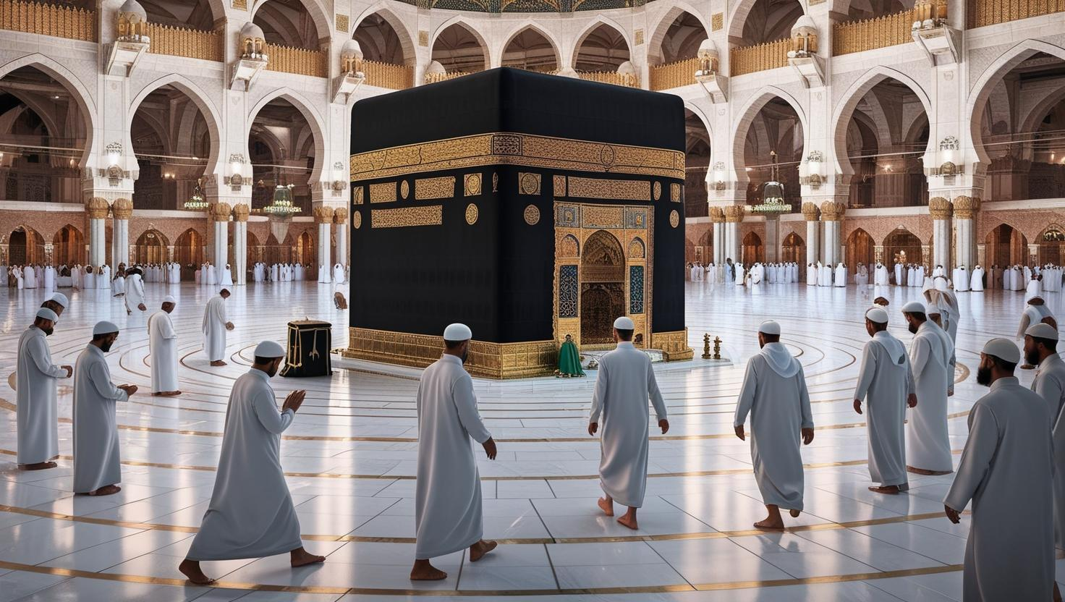

The First Ten Days of Dhul-Hijjah
The Virtues of the First Ten Days of Dhul-Hijjah
The first ten days of Dhul-Hijjah are among the greatest days of the year. Allah swore by them in the Qur’an:
“By the dawn, and the ten nights” [Al-Fajr:1-2].
These days are a golden opportunity to draw closer to Allah through righteous deeds. The Prophet ﷺ said:
“There are no days in which righteous deeds are more beloved to Allah than these ten days.”
O1

Slide 2
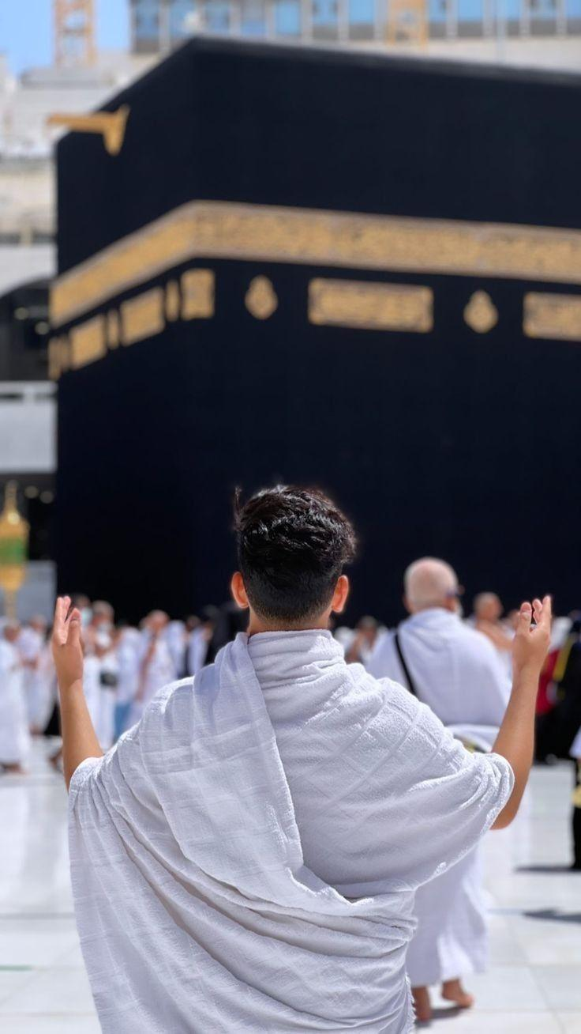
Why Are These Days So Special?
These days combine the major acts of worship: prayer, fasting, charity, and Hajj.
They offer a rare chance to earn immense rewards and have sins forgiven.
Among them is the Day of Arafah, which expiates sins of two years, and the Day of Eid (Al-Nahr), the greatest day in the sight of Allah.
02

Slide 3

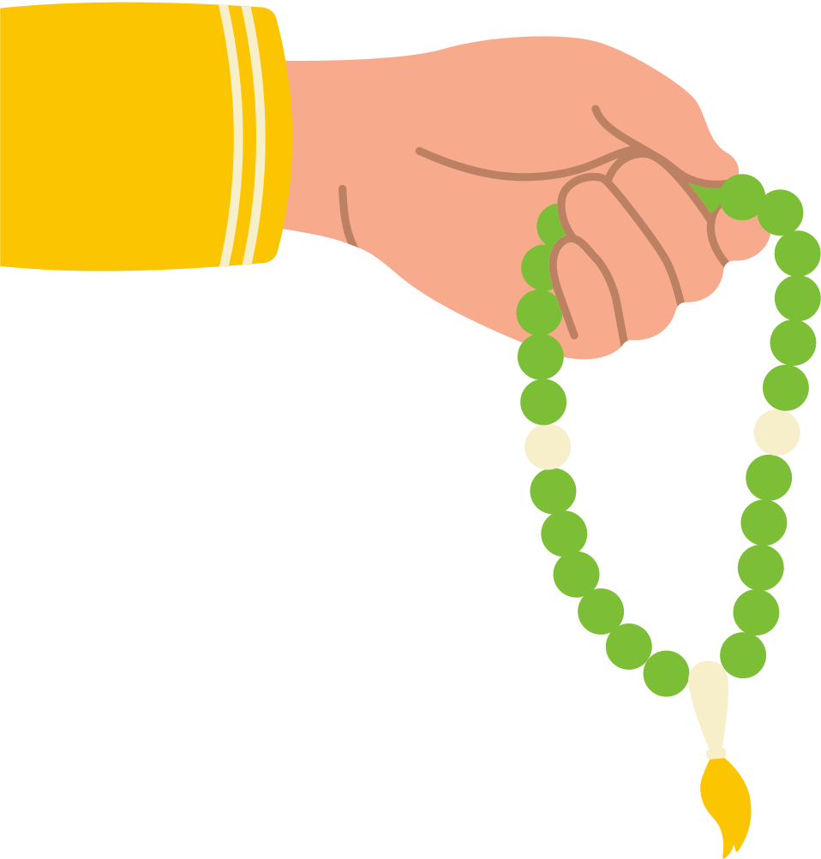
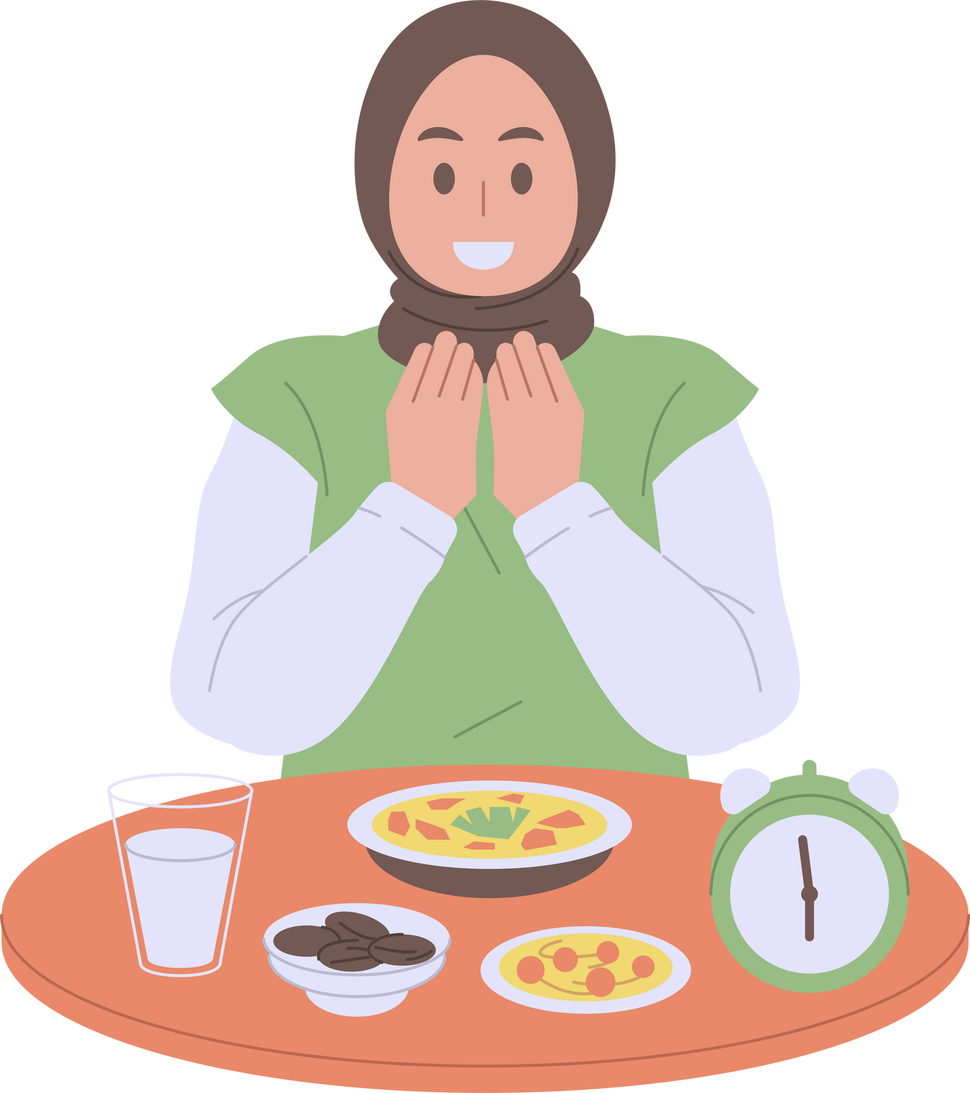
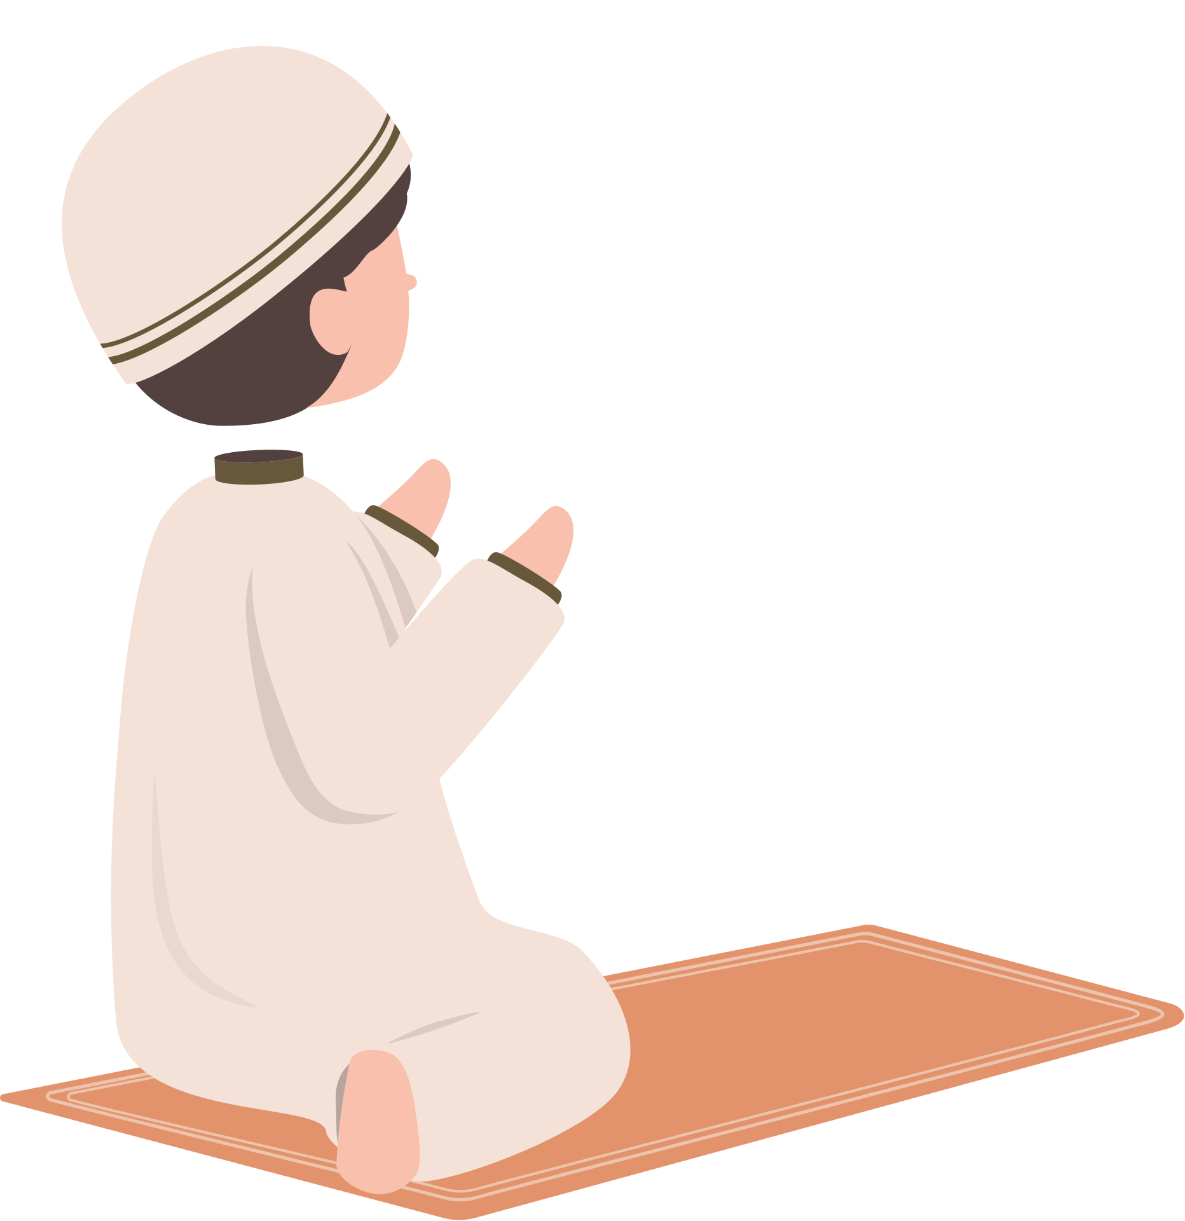


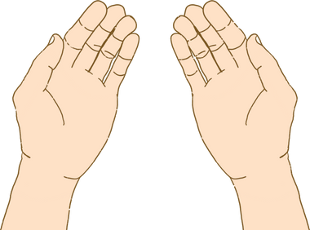
Recommended Deeds During These Days
Saying Takbeer, Tahleel, and Tahmeed frequently
Fasting, especially on the Day of Arafah
Performing voluntary prayers and night prayers
Giving charity and showing kindness to parents
Making abundant supplication (du‘a)
Reading the Qur’an
03

Slide 4




Spiritual
Benefits
Multiplication of rewards
Renewed connection with Allah
04
Purification of the soul and heart
Strengthening of personal piety

Slide 5
  When people increase their good deeds during these days,
  goodness spreads within the community,
  compassion grows,
  and a strong sense of unity and generosity among the Ummah is established.
Impact on Individuals and Society
05

Slide 6
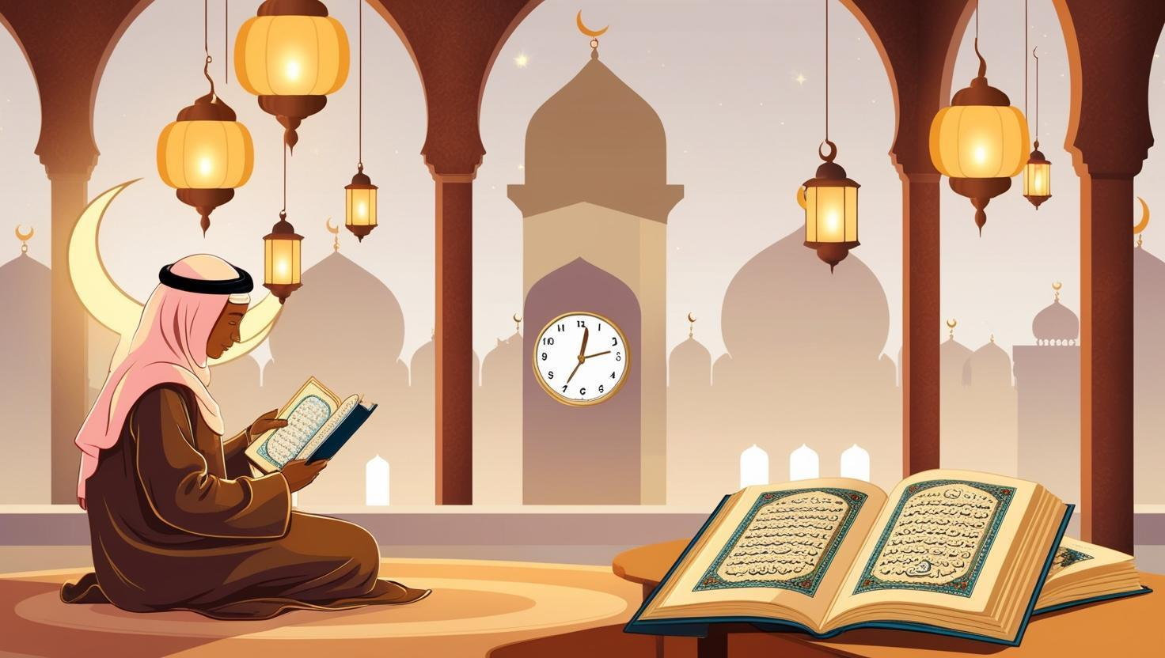

Inspiring Real-Life Stories
A young man repented and started memorizing the Qur’an
A woman regularly gave charity and witnessed her distress lifted
A student fasted the ten days and achieved great academic success
06

Slide 7
The Day of Arafah
A Treasure Not to Be Missed
Fasting on the Day of Arafah expiates sins of the past and coming year.
It is the day on which Allah perfected the religion.
The Prophet ﷺ said:
“Fasting the Day of Arafah, I hope from Allah, will expiate the sins of the year before and the year after.”
07

Slide 8
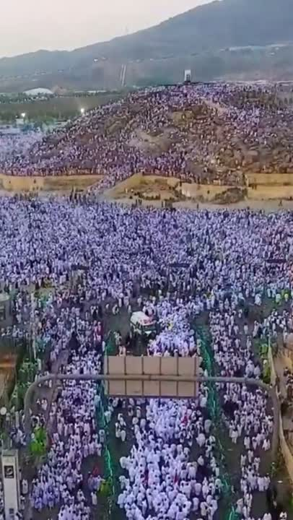
How to Make the Most of These Days
Create a daily worship plan
Allocate time for Qur’an and supplication
Encourage your family and friends to do good deeds
Remember: consistent small deeds are better than sporadic large ones
08

Slide 9
Practical Steps to Seize the Ten Days
  Wake up early and start your day with remembrance
  Dedicate a daily portion for Qur’an reading
  Track your good deeds and evaluate your progress
  Reduce worldly distractions and focus on your hereafter
09

Slide 10
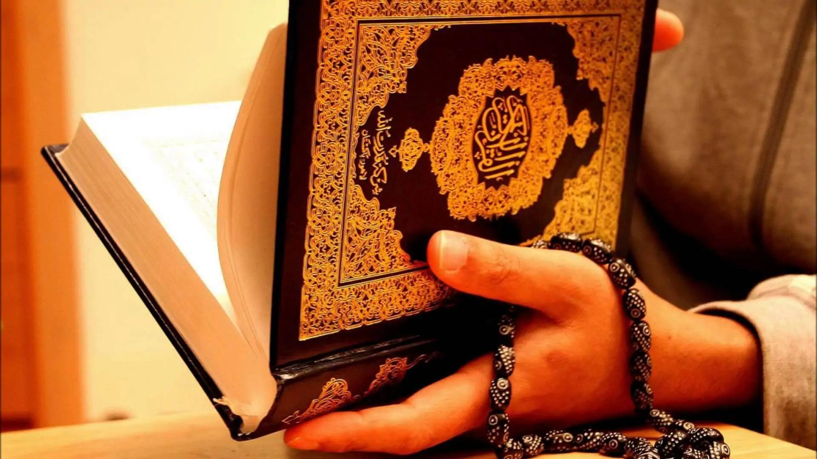

Final Message
  The first ten days of Dhul-Hijjah are a once-a-year opportunity—perhaps your last. Let them be a turning point in your life.
  Don’t delay repentance. Don’t neglect worship.
  Start today, seize the reward, and be among those who earn Allah’s pleasure and Paradise.
10

