Slide 1

الْهِجْرَةُ إِلَى الْحَبَشَةِ
Al-Hijrah ilā al-Ḥabashah
THE MIGRATIONS TO ABYSSINIA
دَرْسٌ تَفَاعُلِيٌّ حَوْلَ هِجْرَةِ الْمُسْلِمِينَ الْأُولَى وَالثَّانِيَةِ
An interactive lesson on the first and second migrations of Muslims.

Slide 2

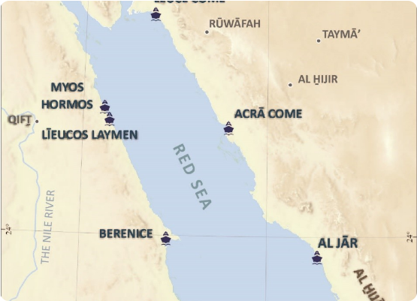
لِمَاذَا الْحَبَشَةُ؟ Why Abyssinia?
أَمَرَ النَّبِيُّ ﷺ : "لَوْ خَرَجْتُمْ إِلَى أَرْضِ الْحَبَشَةِ..."
The Prophet ﷺ said: "If you were to go to Abyssinia..."
مَلِكٌ عَادِلٌ : "فَإِنَّ بِهَا مَلِكًا لَا يُظْلَمُ عِنْدَهُ أَحَدٌ."
"...for there is a king there under whom no one is wronged."
أَرْضُ صِدْقٍ : "وَهِيَ أَرْضُ صِدْقٍ."
"And it is a land of truth."

Slide 3
الْهِجْرَةُ الْأُولَى The First Migration
الزَّمَانُ : رَجَب - السَّنَةُ الْخَامِسَةُ مِنَ الْبِعْثَةِ.
Time: Rajab, 5th year of Prophethood.
16
الْعَدَدُ : 12 رَجُلًا وَ 4 نِسْوَةٍ.
Count: 12 men and 4 women.
مُهَاجِرًا Migrants
أَبْرَزُهُمْ : عُثْمَانُ بْنُ عَفَّانَ وَزَوْجَتُهُ رُقَيَّةُ بِنْتُ رَسُولِ اللَّهِ ﷺ.
Notable: Uthman ibn Affan and his wife Ruqayyah (Prophet's daughter).

Slide 4

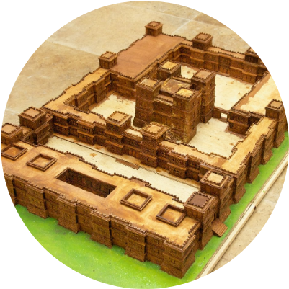
الْمَلِكُ النَّجَاشِيُّ The King An-Najashi
الْأَصْحَمَةُ النَّجَاشِيُّ
Al-Asḥamah an-Najāshī
كَانَ مَلِكًا نَصْرَانِيًّا عَادِلًا رَحِيماً. اسْتَقْبَلَ الْمُسْلِمِينَ وَرَفَضَ تَسْلِيمَهُمْ لِقُرَيْشٍ بَعْدَ أَنْ سَمِعَ عَنِ الْإِسْلَامِ.
He was a just Christian king who welcomed Muslims and refused to hand them over to Quraish after hearing about Islam.

Slide 5

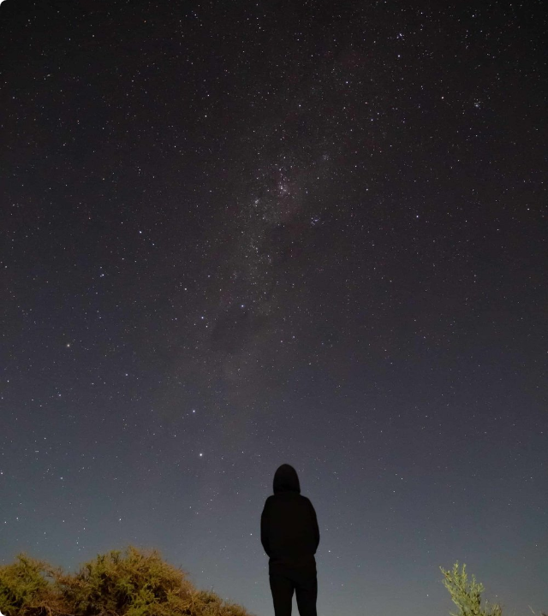
الْهِجْرَةُ الثَّانِيَةُ The Second Migration
بَعْدَ زِيَادَةِ التَّعْذِيبِ فِي مَكَّةَ، هَاجَرَ مَجْمُوعَةٌ أَكْبَرُ مِنَ الْمُسْلِمِينَ.
After increased persecution in Mecca, a larger group of Muslims migrated.
الْعَدَدُ : 83 رَجُلًا وَ 18 امْرَأَةً.
Count: 83 men and 18 women.
الْقَائِدُ : جَعْفَرُ بْنُ أَبِي طَالِبٍ.
Leader: Ja'far ibn Abi Talib.

Slide 6

خِطَابُ جَعْفَرٍ Ja'far's Speech
"أَيُّهَا الْمَلِكُ، كُنَّا قَوْمًا أَهْلَ جَاهِلِيَّةٍ، نَعْبُدُ الْأَصْنَامَ... حَتَّى بَعَثَ اللَّهُ إِلَيْنَا رَسُولًا."
"O King, we were an unlettered people of ignorance, worshipping idols... until Allah sent us a Messenger."
— جَعْفَرُ بْنُ أَبِي طَالِبٍ

Slide 7







مُفْرَدَاتُ الدَّرْسِ Key Vocabulary
أَمَان
عَدْل
مَلِك
هِجْرَة
Amān
'Adl
Malik
Hijrah
SAFETY
JUSTICE
KING
MIGRATION

Slide 8
مُقَارَنَةٌ بَيْنَ الْهِجْرَتَيْنِ Comparison
الْمِيزَةُ (Feature) | الْهِجْرَةُ الْأُولَى (1st) | الْهِجْرَةُ الثَّانِيَةُ (2nd)
الْعَدَدُ (Number) | 16 مُهَاجِرًا | 101 مُهَاجِرٍ
الْمُدَّةُ (Duration) | أَشْهُرٌ قَلِيلَةٌ | سَنَوَاتٌ طَوِيلَةٌ
الْقَائِدُ (Leader) | عُثْمَانُ بْنُ عَفَّانَ | جَعْفَرُ بْنُ أَبِي طَالِبٍ

Slide 9



التَّسَلْسُلُ الزَّمَنِيُّ Timeline
الْعَوْدَةُ
الْهِجْرَةُ 2
الْهِجْرَةُ 1
الْبِعْثَةُ
سَنَة 7 هِجْرِي
سَنَة 7
سَنَة 5
سَنَة 1

Slide 10

نُمُوُّ الْمُجْتَمَعِ Community Growth
زِيَادَةُ عَدَدِ الْمُسْلِمِينَ بَعْدَ الْهِجْرَةِ إِلَى الْحَبَشَةِ.
Increase in the number of Muslims after migrating to Abyssinia.

Slide 11




تَدْرِيبٌ تَفَاعُلِيٌّ Interactive Practice
تَرْجِمْ إِلَى الْإِنْجِلِيزِيَّةِ
تَرْجِمْ إِلَى الْعَرَبِيَّةِ
أَرْضُ صِدْقٍ
"THE KING IS JUST."
Arḍu ṣidq
الْمَلِكُ عَادِلٌ
"A LAND OF TRUTH."
Al-Maliku ‘ādil

Slide 12

جَزَاكُمُ اللَّهُ خَيْرًا
THANK YOU
هَلْ لَدَيْكُمْ أَيُّ أَسْئِلَةٍ؟
Do you have any questions?
WWW.QURANEST.COM

Slide 13



Image Sources
https://brill.com/view/journals/djap/2/1/29501768_002_01_s006_i0001.jpg
Source: brill.com
https://www.worldhistory.org/img/r/p/1500x1500/10271.jpg
Source: www.worldhistory.org
https://images.squarespace-cdn.com/content/v1/58d95f3bf5e231abb460fca7/1780172781802-IGQYOEJ98X2C040BTJXM/_MG_2901_compressed.jpg?format=1000w
Source: mybibimbaplife.com

