Slide 1



QURANEST | قرآنست
The Remembrance of Allah
الأَذْكَارُ وَأَنْوَاعُهَا
Level 1: The Concept and Core Types of Daily Adhkar
Al-Adhkār wa Anwā'uhā

Slide 2
The Concept of Adhkar
تَعْرِيفُ الأَذْكَارِ وَمَفْهُومُهَا
Understanding the true linguistic and spiritual meanings of remembrance
The Spiritual Essence of Divine Devotion

Slide 3


What is Adhkar?
مَفْهُومُ الذِّكْرِ لُغَةً وَشَرْعاً
Linguistic and Spiritual Scope
Adhkar refers to all words and phrases through which a believer consciously remembers and glorifies their Creator. This is performed via:
•
Glorifying Allah: Tasbeeh & Tahmeed
•
Exalting Him: Takbeer & Tahlil
•
Supplication: Du'a and seeking His aid
Remembering the Divine preserves peace in our worldly affairs.

Slide 4

The Importance of Adhkar
طَاعَةُ اللهِ وَالقُرْبُ مِنْهُ
الحِفْظُ وَالْوِقَايَةُ مِنَ الشَّيْطَان
Divine Connection
Spiritual Shield
Drawing closer to Allah
Protection from whispers
Adhkar is considered one of the easiest yet most powerful acts of worship. It maintains an active, direct link between the believer and their Creator at all times.
Daily remembrances build a spiritual fortress around the mind and heart, shielding the soul from whisperings of shaytan and anxiety.

Slide 5
The Divine Promise
"So remember Me; I will remember you."
"
"
{فَاذْكُرُونِي أَذْكُرْكُمْ}
Fadhkurūnī adhkurkum
Surah Al-Baqarah: Ayat 152

Slide 6

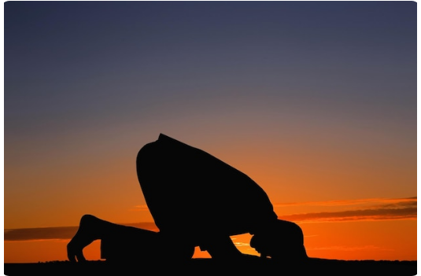
Core Categories of Adhkar
تَقْسِيمَاتُ الأَذْكَارِ الرَّئِيسِيَّةُ
Divided by Time & Context
Islamic scholars categorize the authentic supplications from the Sunnah into three main groups to fit our daily actions:
•
General (Absolute): Words recited at any time without limitation.
•
Specific (Restricted): Supplications tied to events, times, or places.
•
Day & Night: Crucial morning and evening protective sets.

Slide 7






General Adhkar (Absolute)
سُبْحَانَ اللهِ وَبِحَمْدِهِ
اللهُ أَكْبَر
أَسْتَغْفِرُ الله
Glorification
Magnification
Repentance
Subḥān-Allāhi wa bi-ḥamdih
Allāhu Akbar
Astaghfiru-Allāh
"Glory be to Allah & His praise." Easy on the tongue, heavy on the scales.
"Allah is the Greatest." Internalizes the ultimate greatness of the Creator.
"I seek forgiveness from Allah." To wash away sins and invite blessings.

Slide 8
Specific Adhkar (Restricted)
Post-Obligatory Prayer (Salah Adhkar):
Recited immediately after the completion of obligatory prayers. Includes Tashbeeh, Tahmeed, and Ayat al-Kursi to seal and elevate the reward of worship.
Sleep & Awakening (Sleep Adhkar):
Formulated protection to guard the sleeping soul, ward off bad dreams, and begin the next day with gratitude ("All praise is due to Him who brought us back to life...").
Entering & Leaving Actions (Everyday Adhkar):
Specific protective words tailored for leaving/entering the home, stepping into the mosque, wearing clothes, and starting meals to inject barakah into the details of daily life.

Slide 9

Daily Morning & Evening Adhkar
Category & Arabic Name | Prescribed Timing | Intended Blessings & Spiritual Impact | Interactive Guide
Morning Adhkar أَذْكَارُ الصَّبَاحِ | From Fajr dawn until sunrise | Guards the day, expands the chest, and brings divine blessing (Barakah) in one's work and study. | Play Guide
Evening Adhkar أَذْكَارُ الْمَسَاءِ | From Asr afternoon until sunset | Brings inner peace, tranquility, and seals protection for the night, ensuring a peaceful sleep. | Play Guide

Slide 10

Building a Daily Adhkar Habit
Step 2
Step 4
Anchor to Routines: Bind the supplications directly to habits, like waking up, commuting, or right after prayers.
Mindful Reflection: Internalize the deep meanings of these powerful names and attributes to calm the heart.
Step 1
Step 3
Start Small: Focus on short formulas like 100 repetitions of سبحان الله وبحمده to easily build early momentum.
Use Audio Guides: Practice with Quranest interactive audios to polish pronunciation, vowels, and flows.

Slide 11
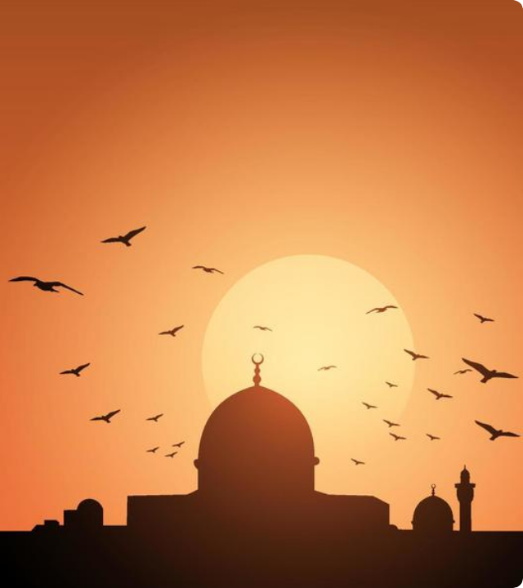
Spiritual & Mental Benefits
ثَمَرَاتُ وَفَوَائِدُ الأَذْكَارِ النَّفْسِيَّةِ
Tranquility and Mental Relief
Establishing daily remembrances has a direct positive impact on a student's mental health and emotional well-being by:
Strengthening resilience and connection to Allah.
Reducing everyday stress, worries, and anxiety.
Bringing profound spiritual clarity to busy schedules.

Slide 12


QURANEST | قرآنست
{أَلَا بِذِكْرِ اللَّهِ تَطْمَئِنُّ الْقُلُوبُ}
"Unquestionably, by the remembrance of Allah hearts are assured."
Surah Ar-Ra`d: Ayat 28

